Slide 1
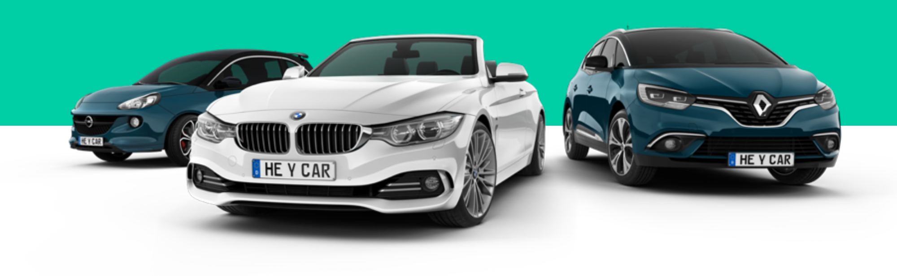
Used Cars Market Analysis:
From Data Scrapping to Tableau
Ivan Velić

Slide 2

Introduction
OVERVIEW
Current Trends:
Reduction in CO2 Emissions and Fuel Consumption
Accelerated Electrification
Impact of the COVID-19 Pandemic
ANALYSIS OBJECTIVE
Uncover insights for informed decision-making and a deeper understanding of the second-hand car market.
Provide recommendations using analysis findings to gain a competitive edge in the dynamic second-hand car market.

Slide 3
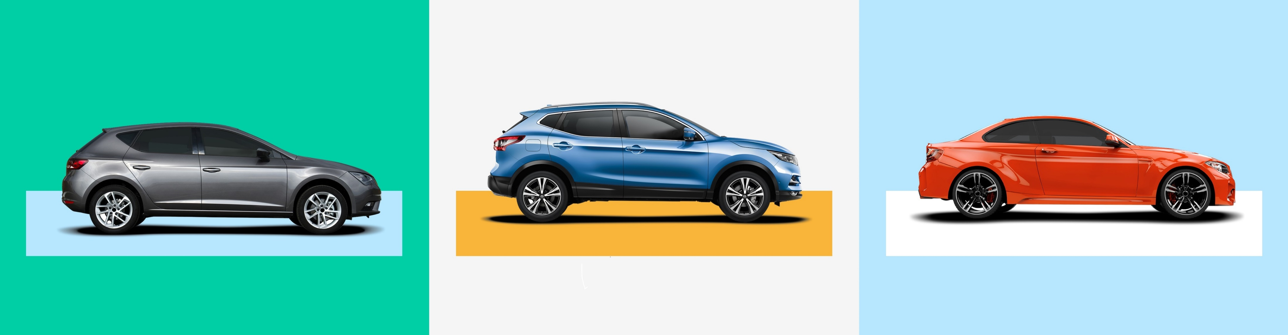
Data sourcing
To understand these effects, I analyzed the largest car market in Europe, to identify customer preferences and behaviors.
Data for this analysis was obtained through web scraping from hey.car, a popular German car advertisement website.

Slide 4














Overview of technology used

Slide 5
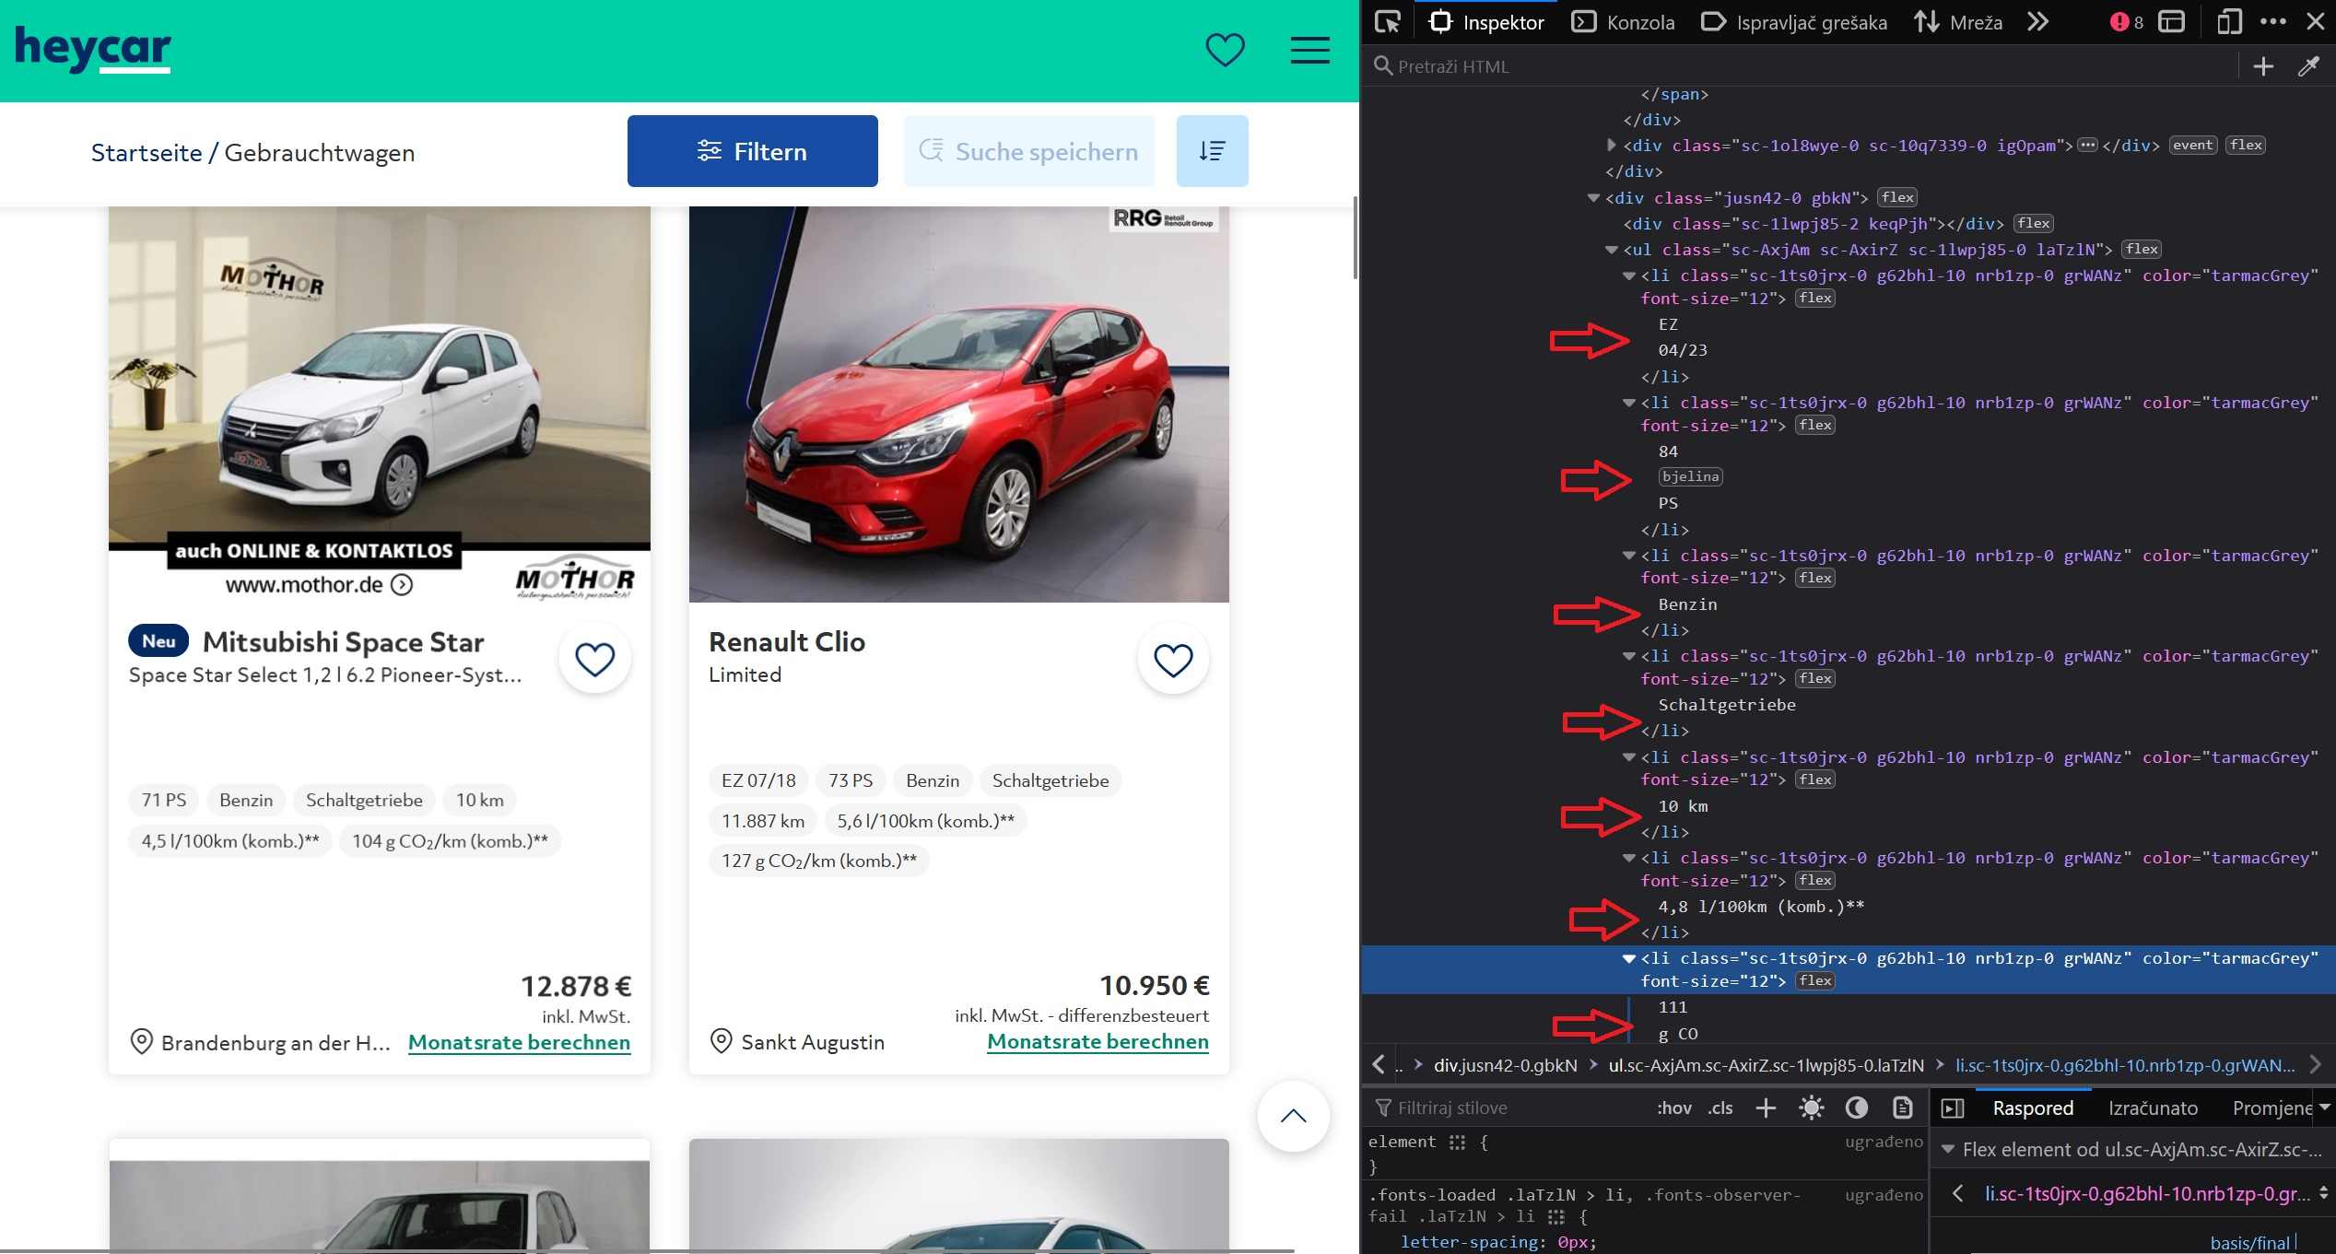
Data Collection
While scraping the website, I encountered challenges due to the web site protective measures implemented.
9 DATA SETS
Overall Data set contains information on all car ads without any specific filters applied.
In addition to the overall data, I scraped 8 separate datasets, each focusing on one of the 8 most popular car brands.
Total data scraped:
273 625

Slide 6
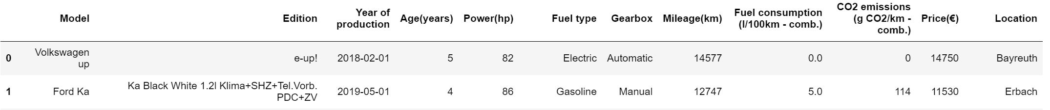
Data Cleaning, Conversion, and Storage
CLEANING AND CONVERSION
STORING IN DATABASE

Slide 7
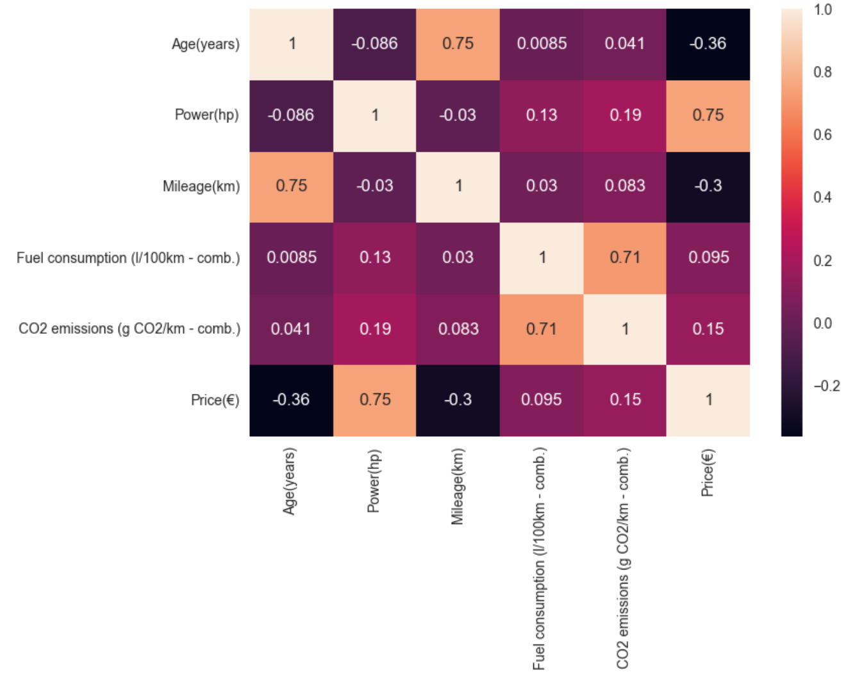
Exploratory Data Analysis
CORRELATION ANALYSIS

Slide 8
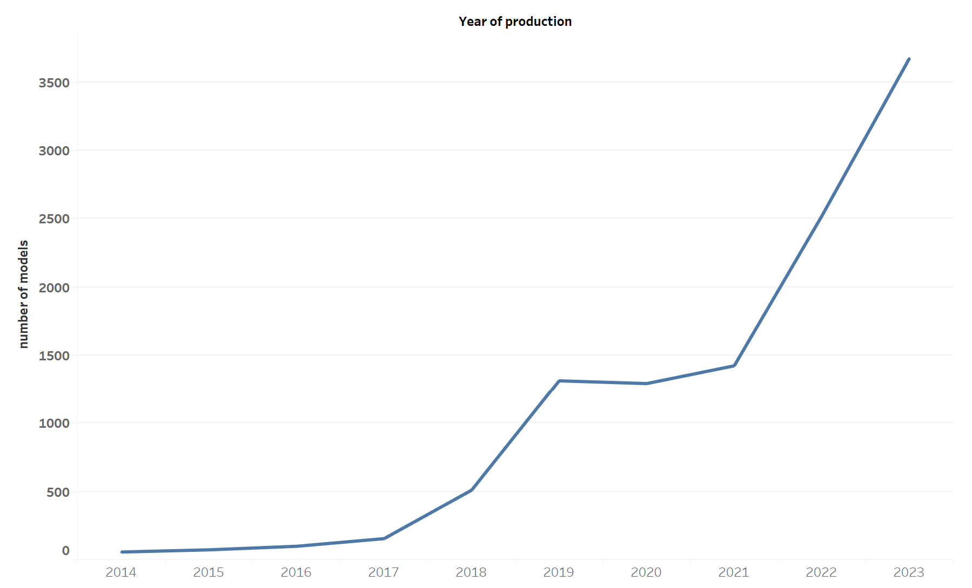
Exploratory Data Analysis
YEAR OF PRODUCTION

Slide 9
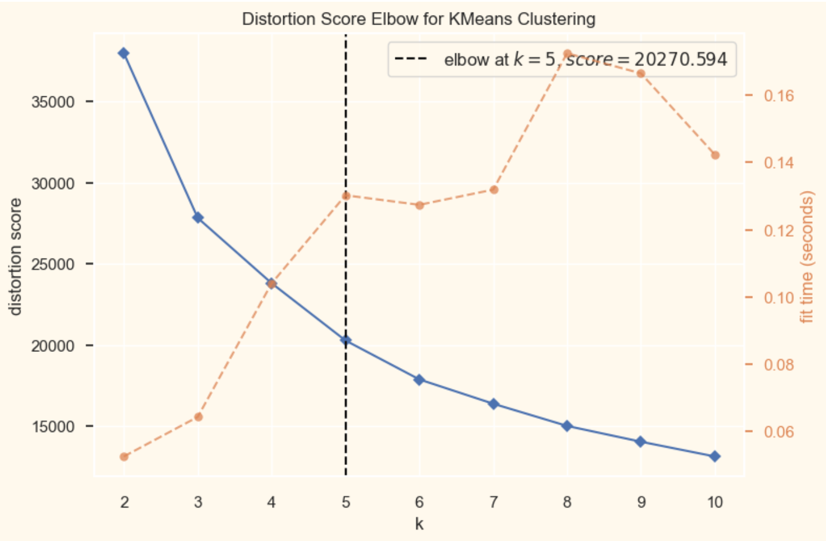
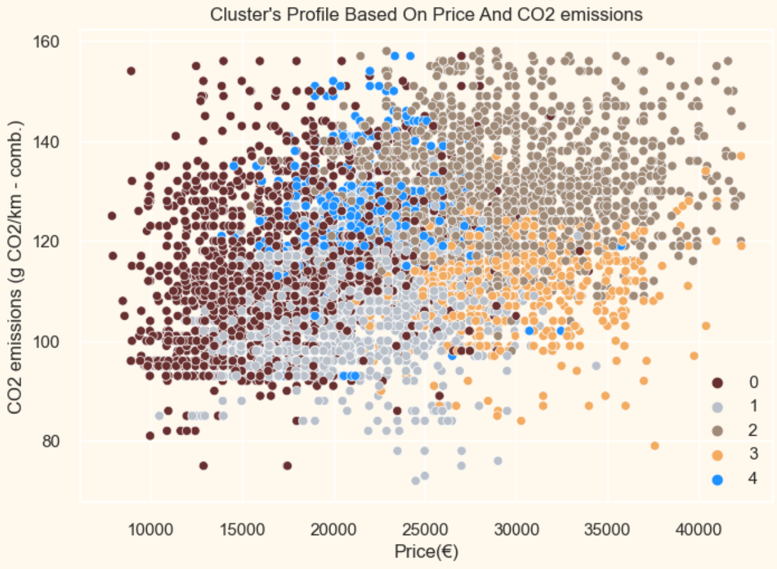
Clustering
Elbow method to determine the number of clusters to be formed
One of Cluster’s Profiles

Slide 10
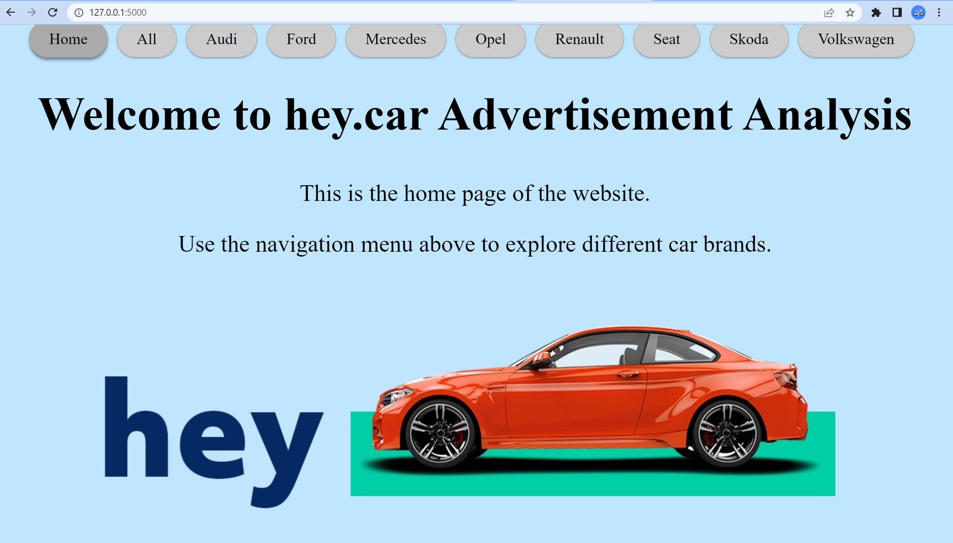
Web application
Using Flask I produced a user-friendly web application for convenient review of analysis results.

Slide 11
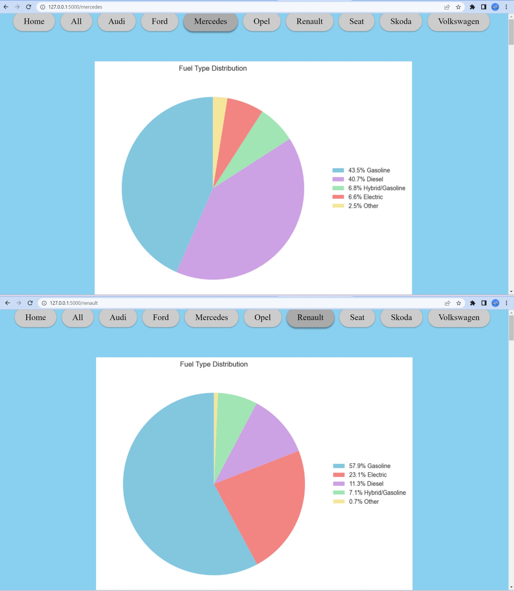
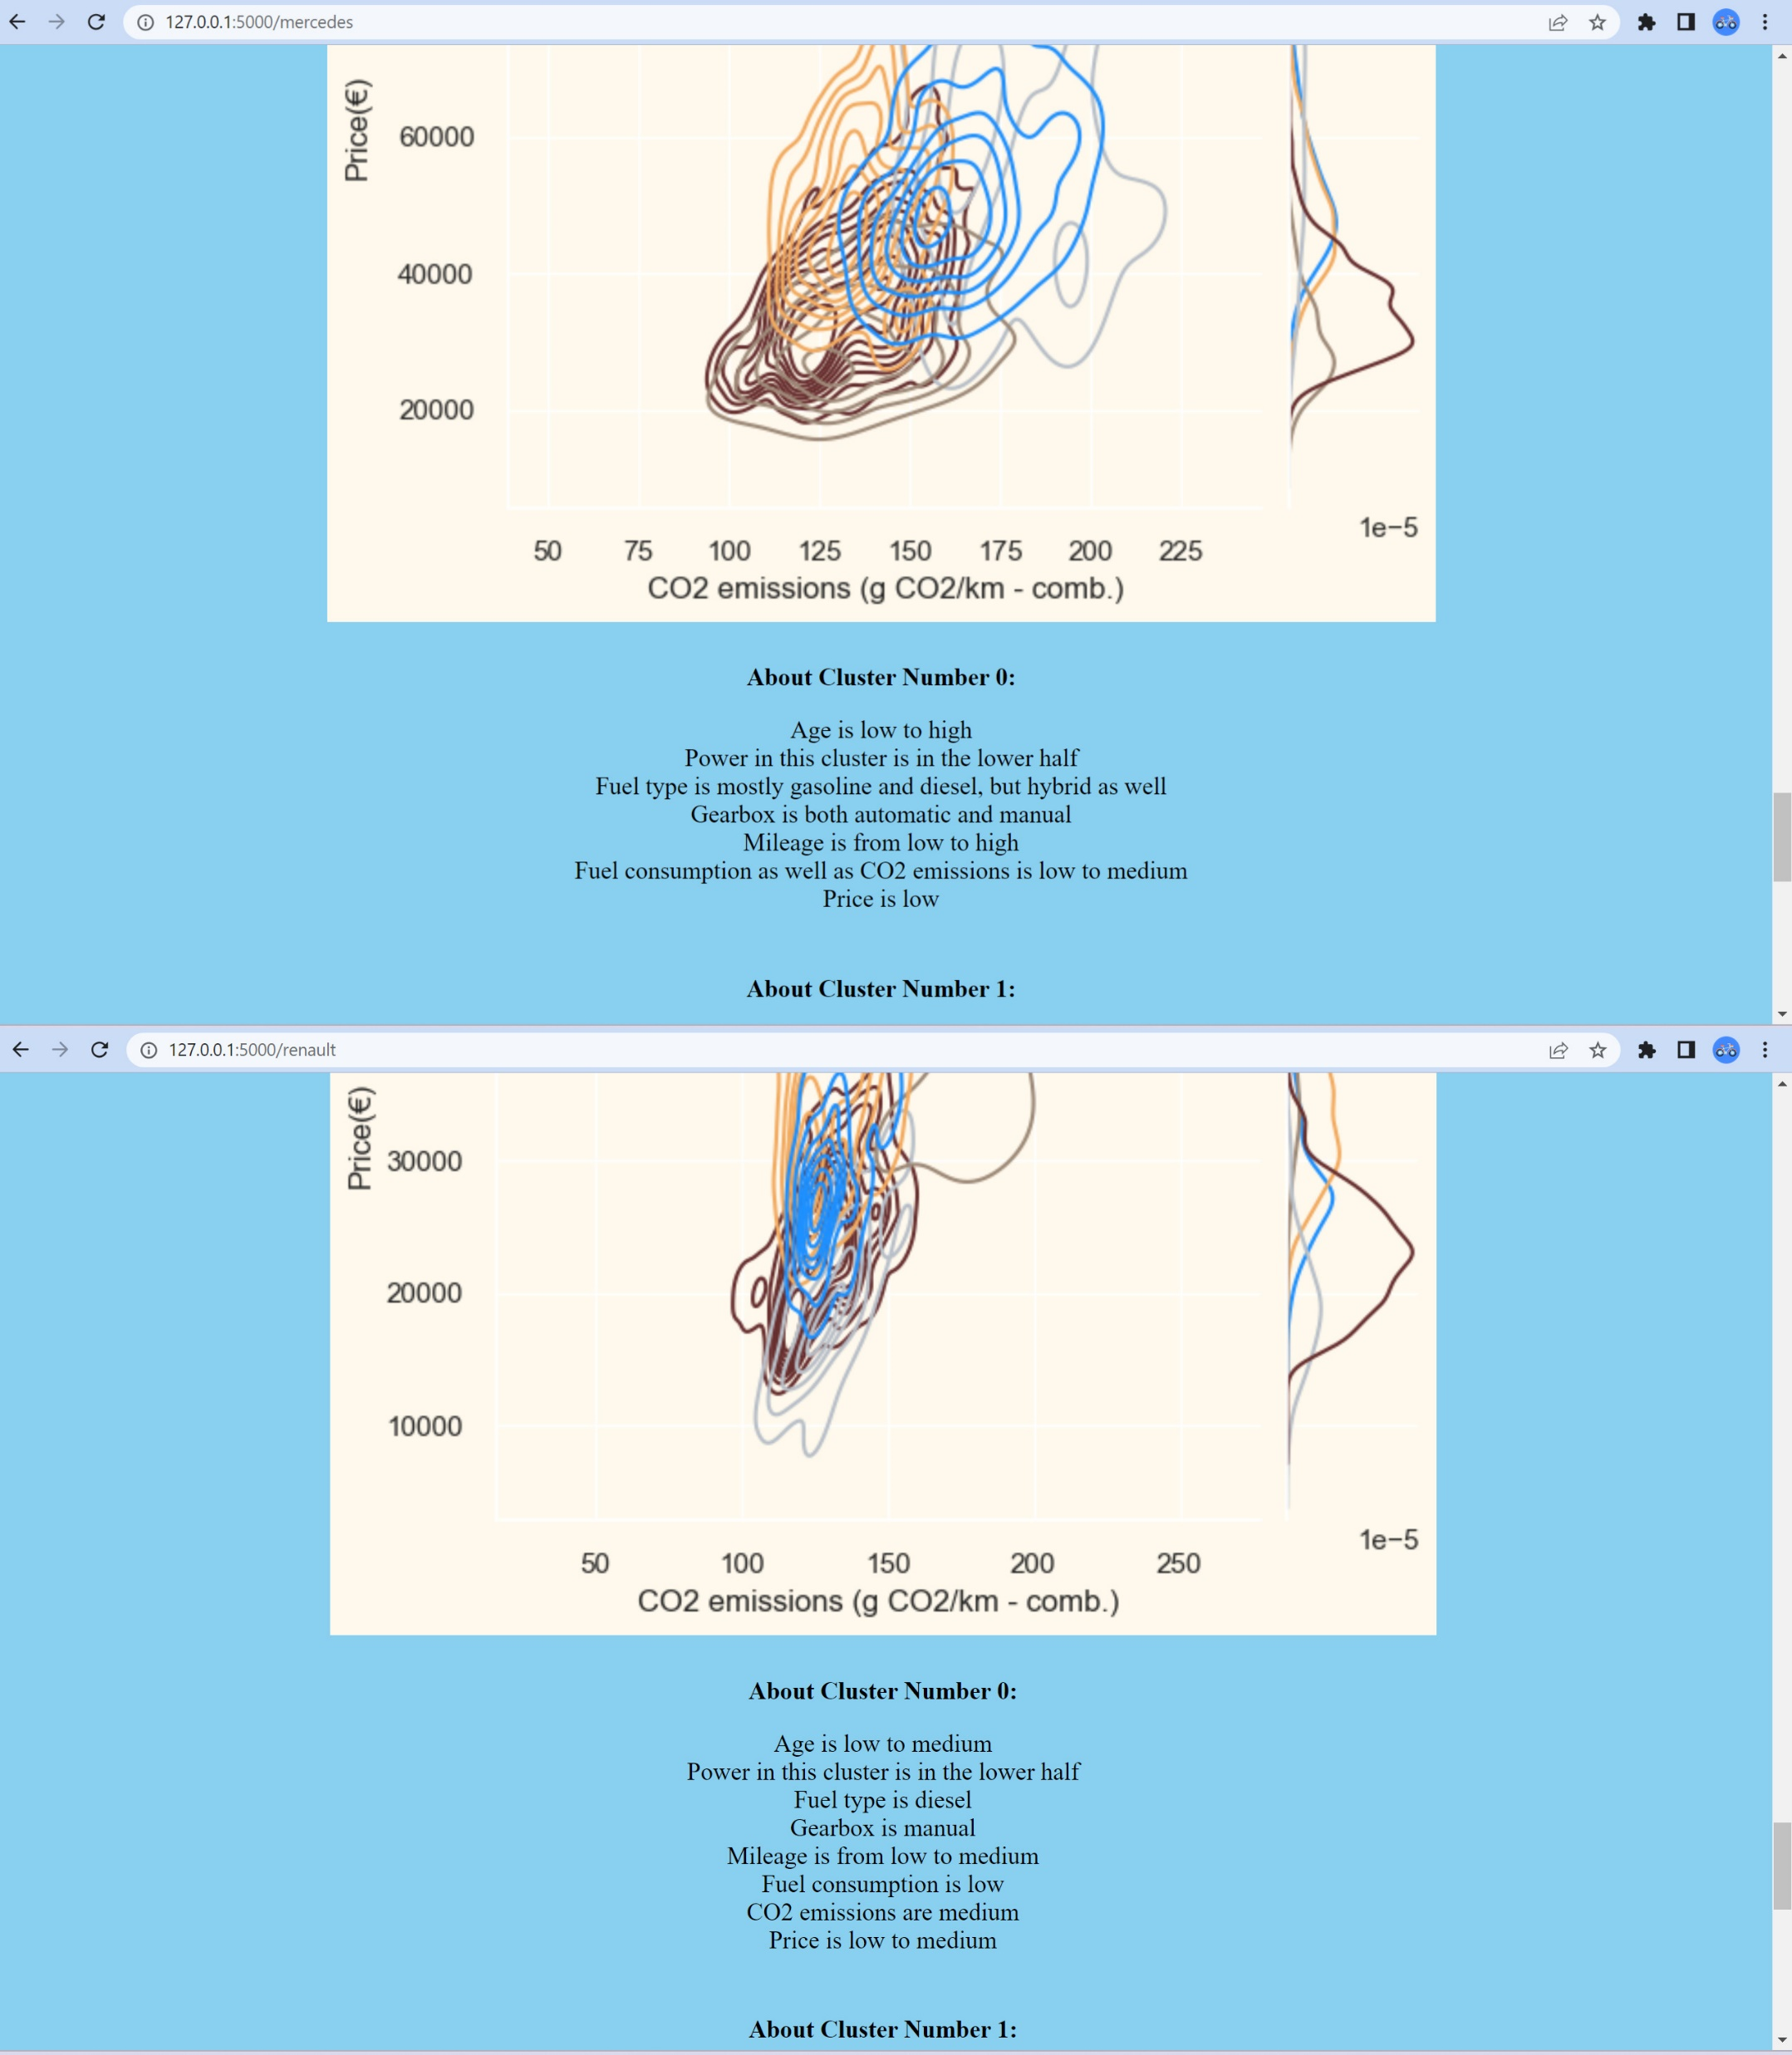
Web application

Slide 12
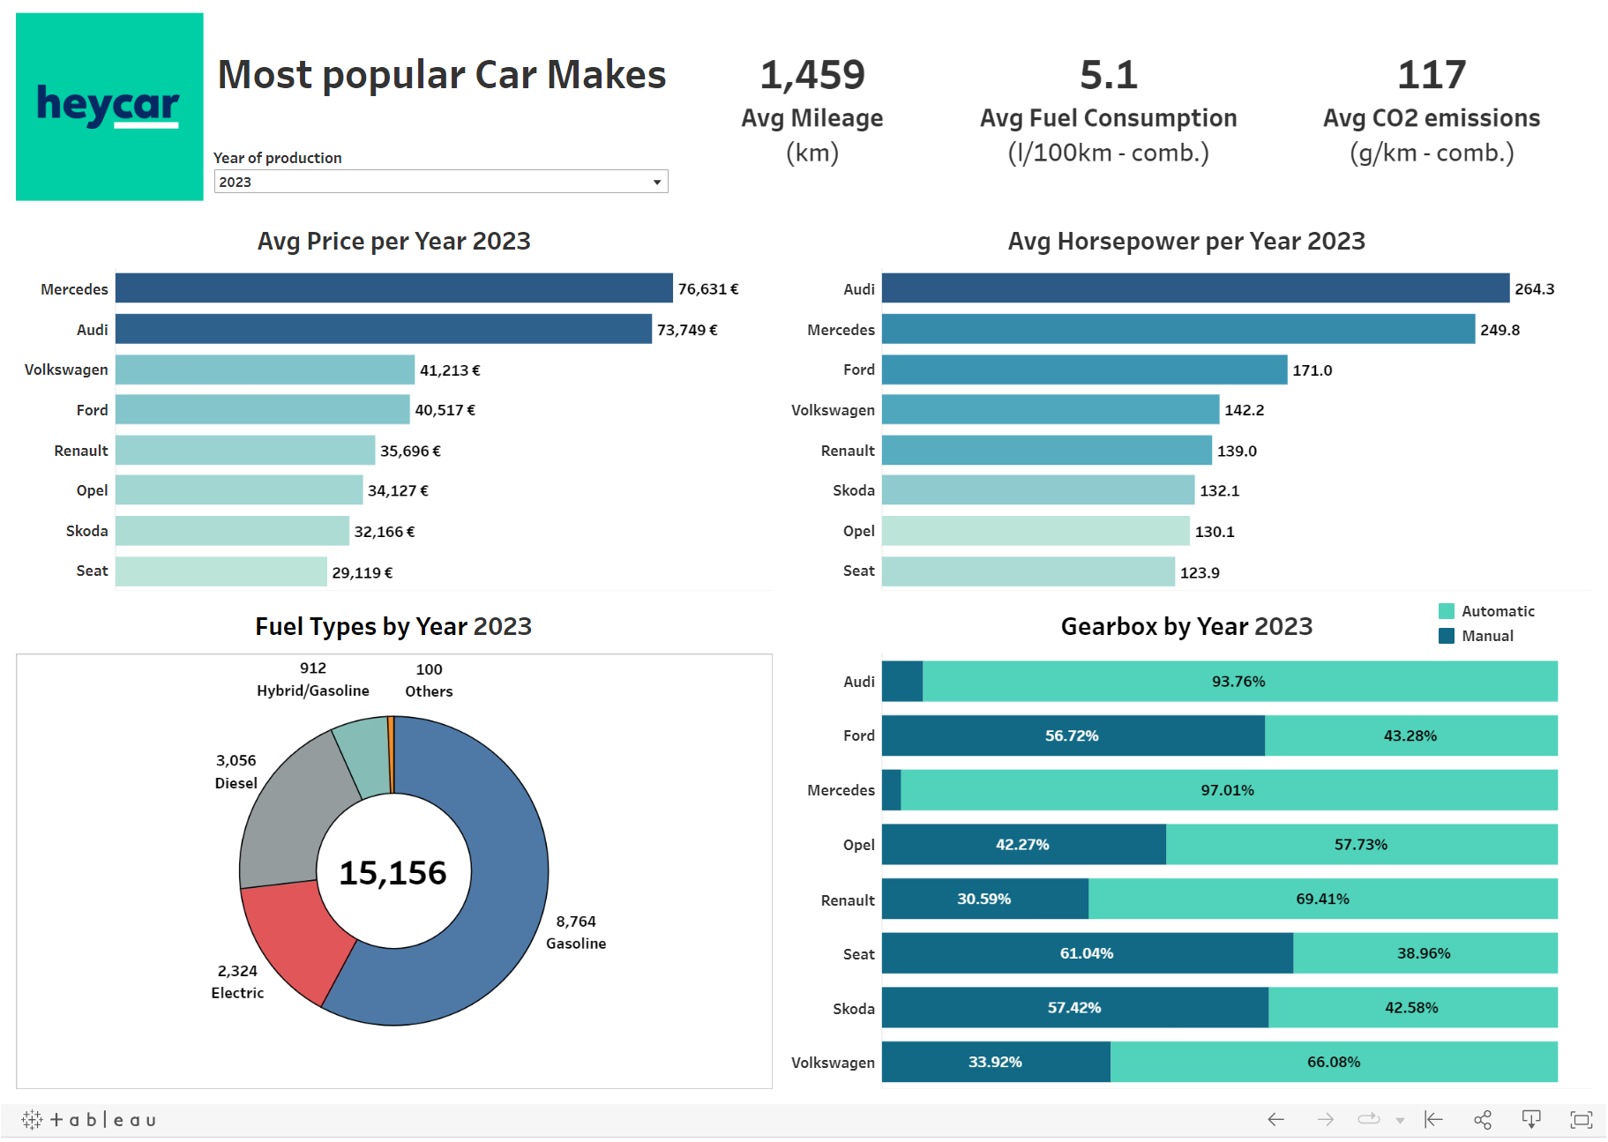
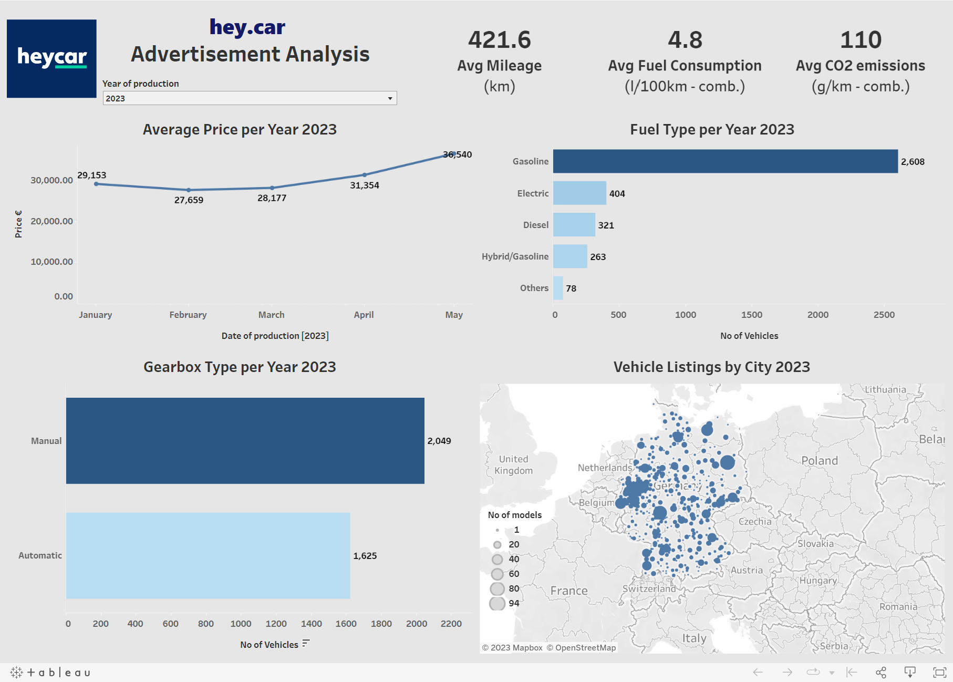
Tableau

Slide 13
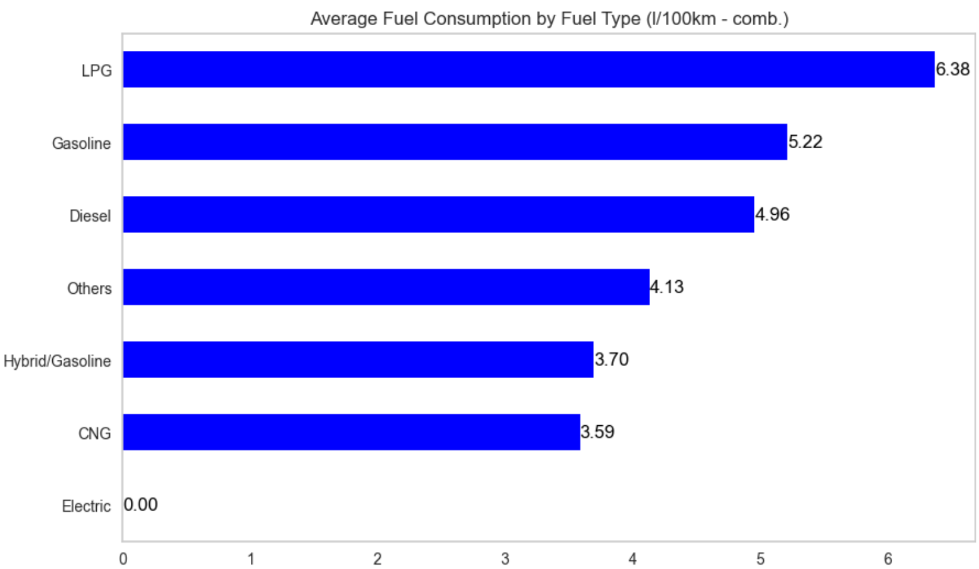
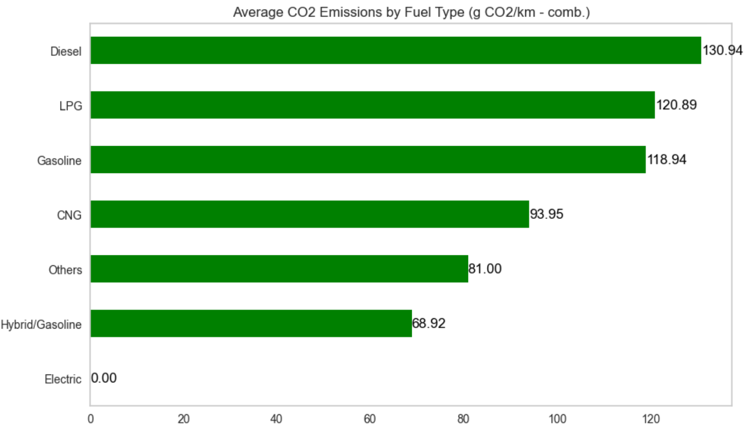
Key Findings and Trends

Slide 14
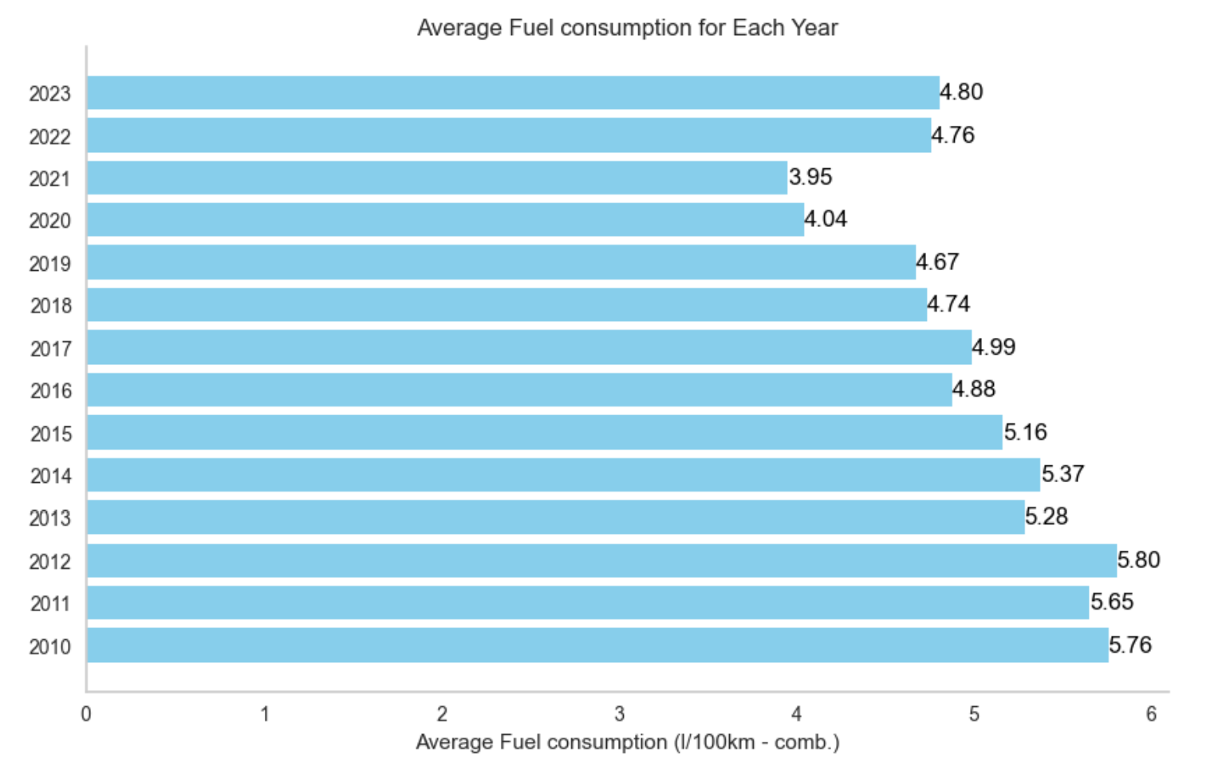
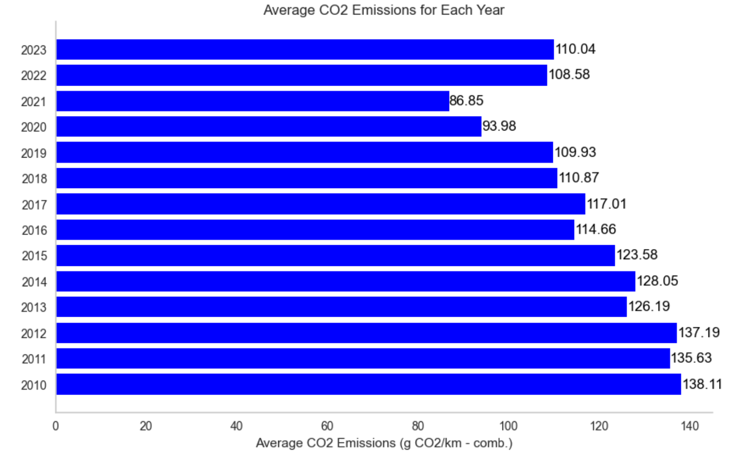
Key Findings and Trends

Slide 15
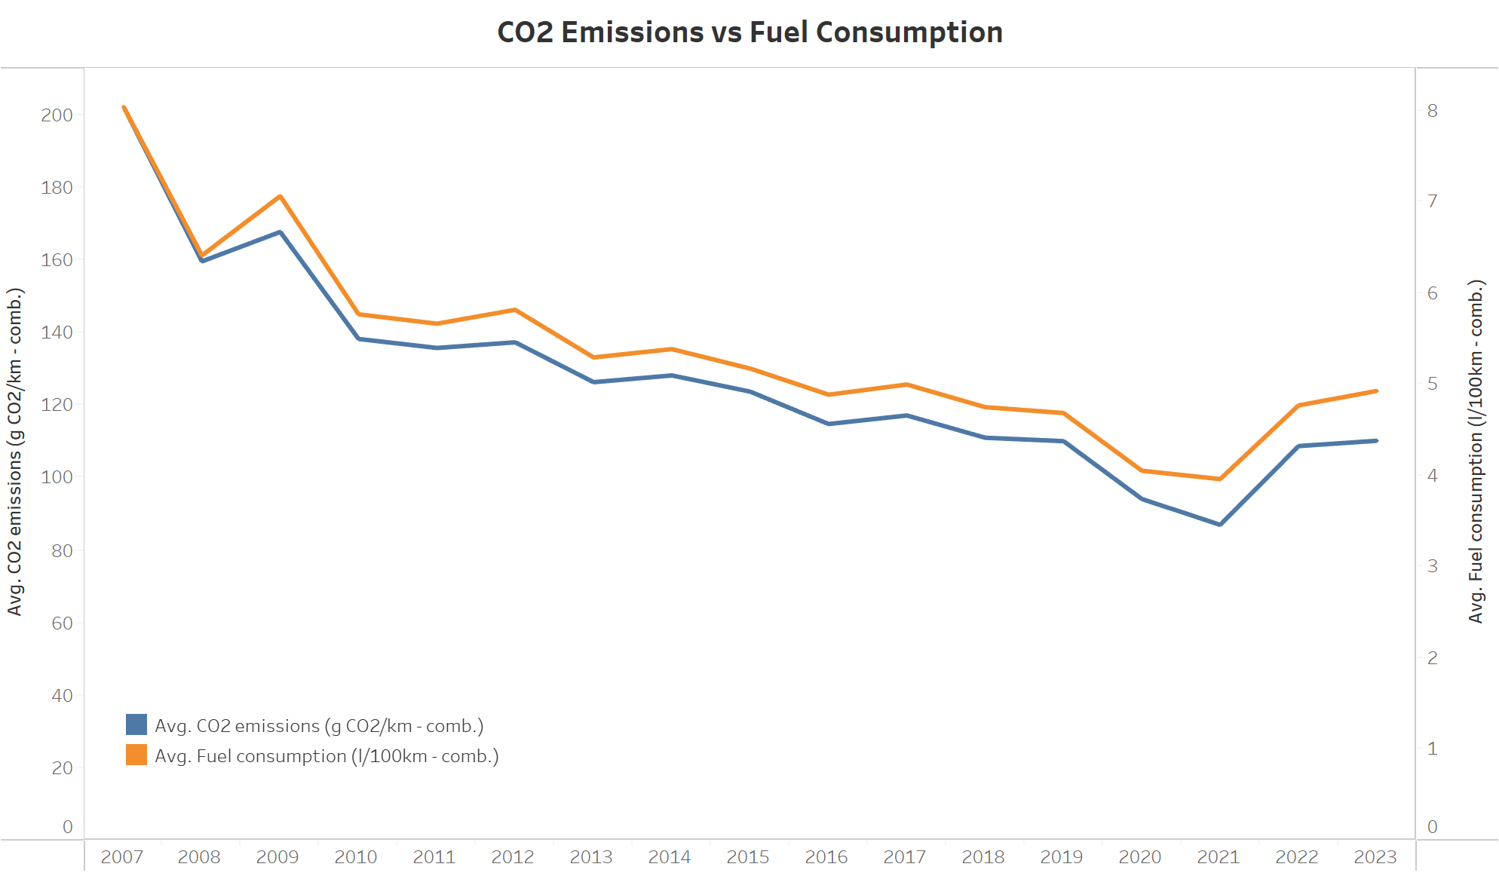
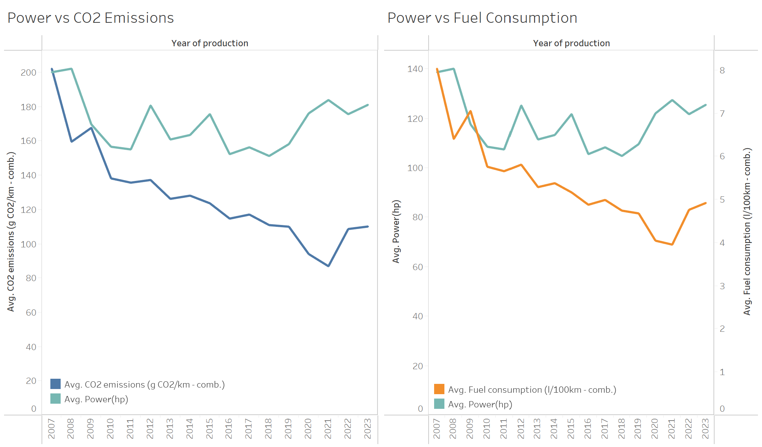
Key Findings and Trends
The rise in fuel consumption and CO2 emissions over the past two years can be attributed to the increased power of newer vehicles.

Slide 16
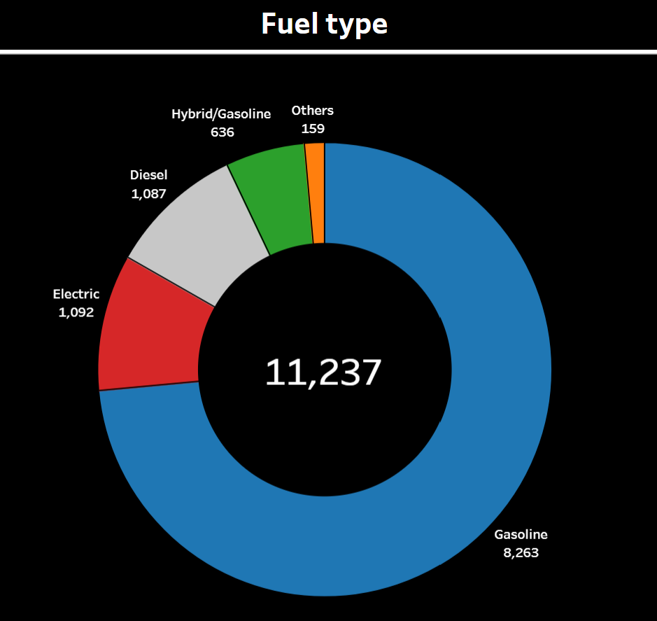
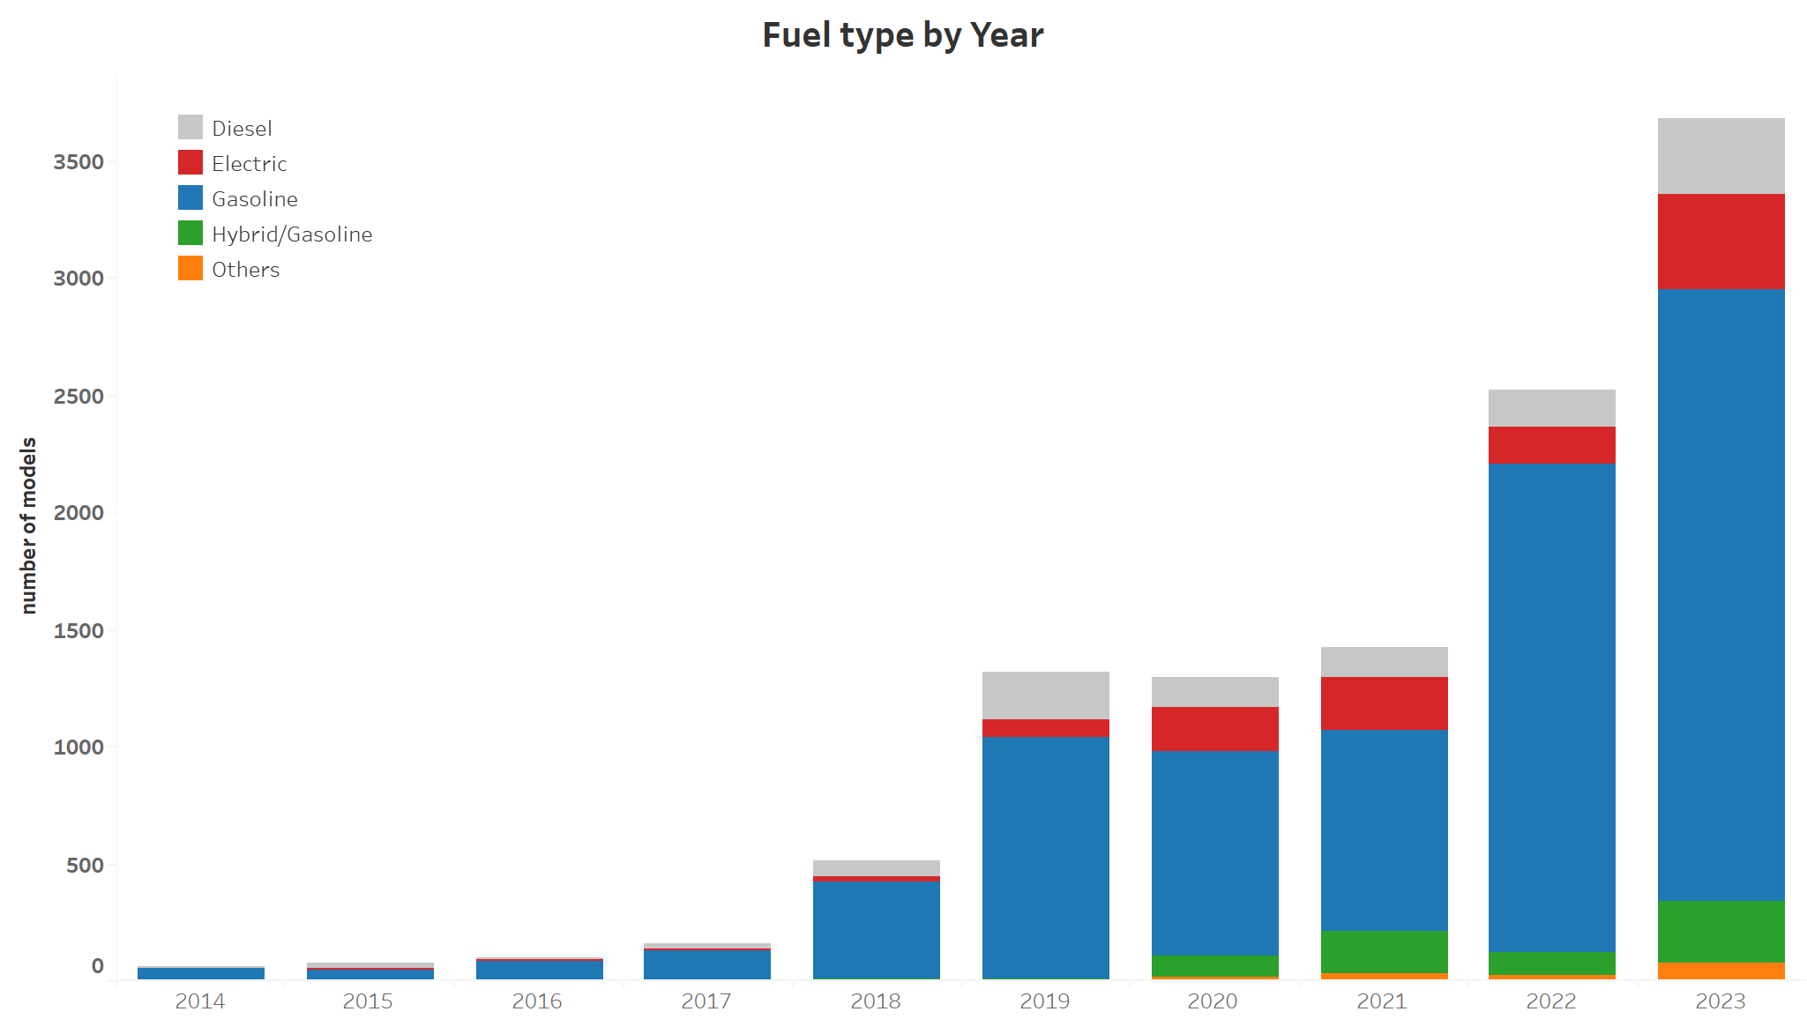
Key Findings and Trends
The dataset analysis showed that the number of electric cars available in the market exceeds the number of diesel cars.

Slide 17
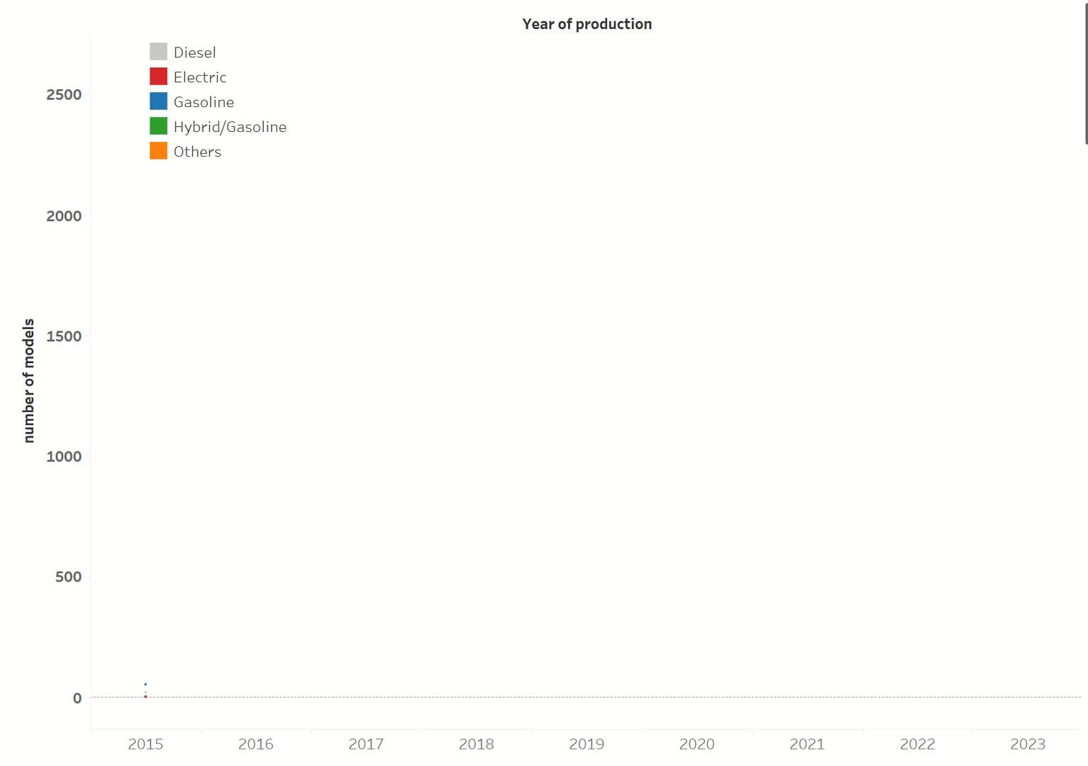
Key Findings and Trends
Dynamic visualization in Tableau focuses on the remarkable ascent of electric vehicles, positioning them in second place within the fuel type hierarchy.

Slide 18
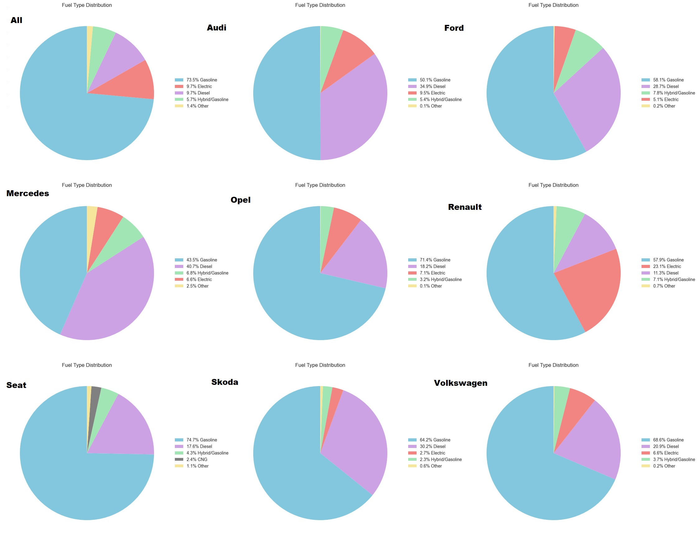
Key Findings and Trends
When analyzing the most popular makes in the second-hand car market only one boasts a significant share of electric vehicles, although, as I already mentioned, the overall result shows electric vehicles in second place.
New players on the market?

Slide 19
Thank you for your attention

